Slide 1
Bioimaging data analysis on the HPC
Trainers: Benjamin Pavie, Sebastian Munck, Tatiana Woller
Contributors: Bruna Piereck, Janick Matthys, Alexander Botzki
29/05/2024, Leuven

Slide 2
Session 1: HPC organization and access
29/05/2024, Leuven

Slide 3
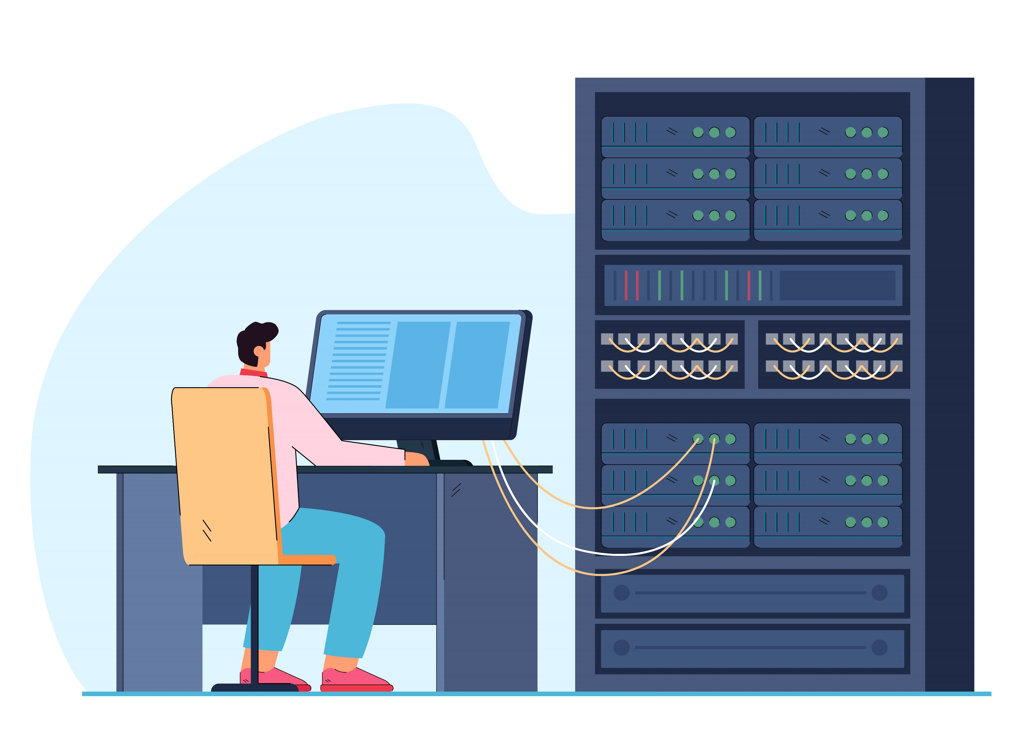
To cover in this course
1. When and what part of HPC to use for a specific task
2. How to use Bioimage analysis
Desktop (Napari)
Jupyterlab and similar
3. Where to find additional resources for reproducible analysis/training
by @pch.vector on freepik
Notes:
Man using HPC image: https://www.freepik.com/free-vector/man-engineer-working-computer-server-rack-switchboard-guy-switching-panel-cabinet-with-plugged-ethernet-optical-cables-telecommunications-engineering-concept-flat-illustration_20827816.htm

Slide 4
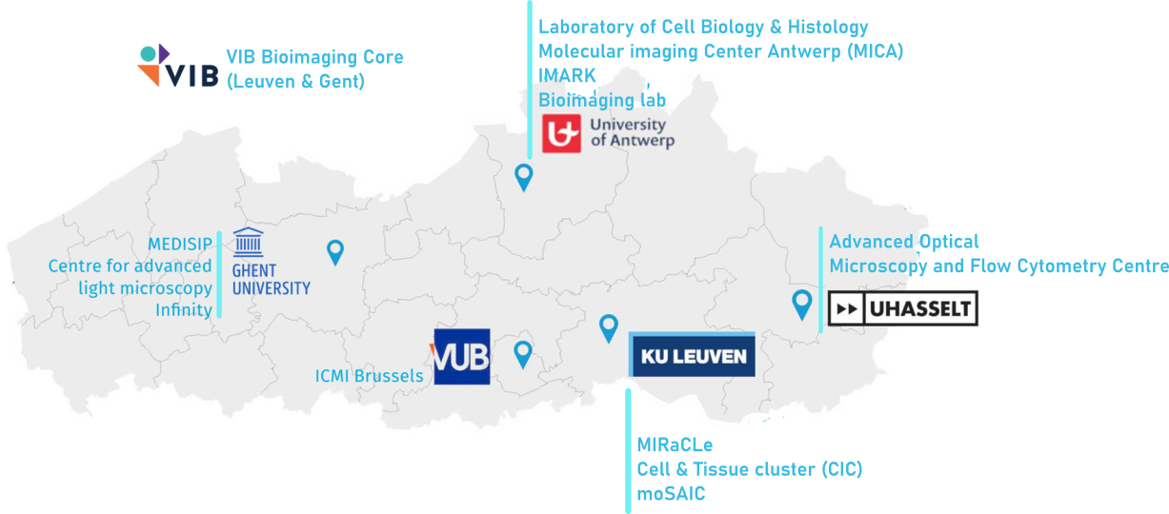

A consortium of state-of-the-art imaging facilities
Innovative services
Collaborative imaging
Technology development
(2023: Euro-BioImaging node)
Notes:
Let Sebastian talk ☺

Slide 5


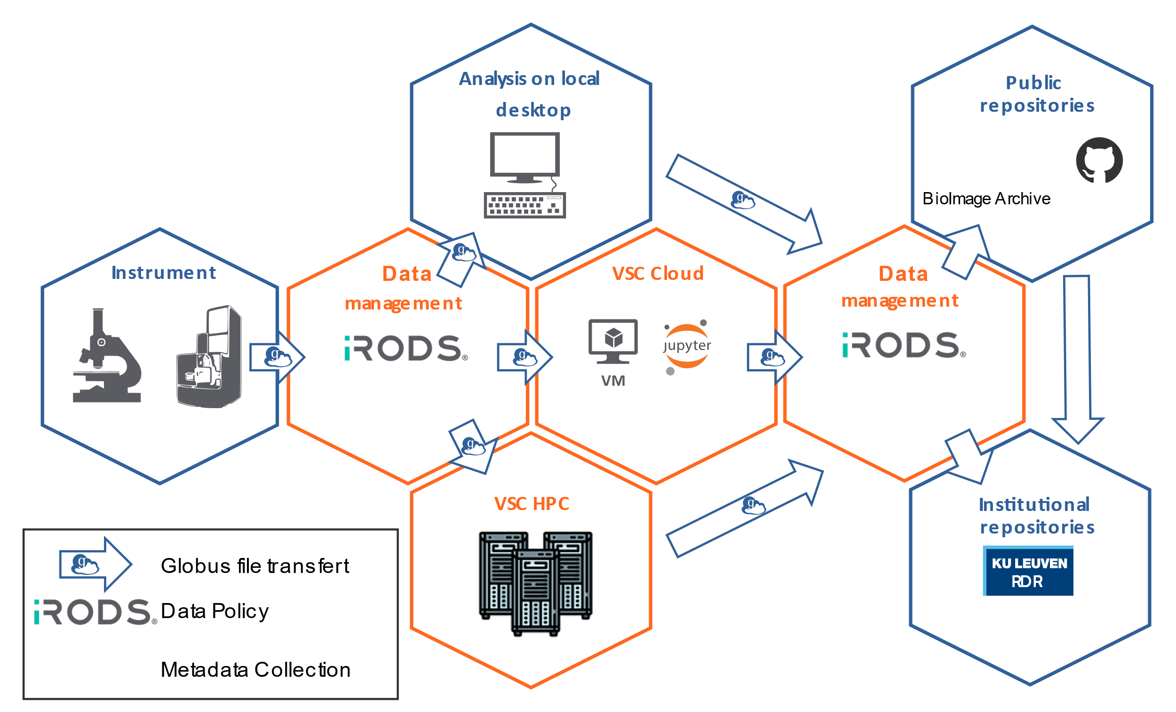






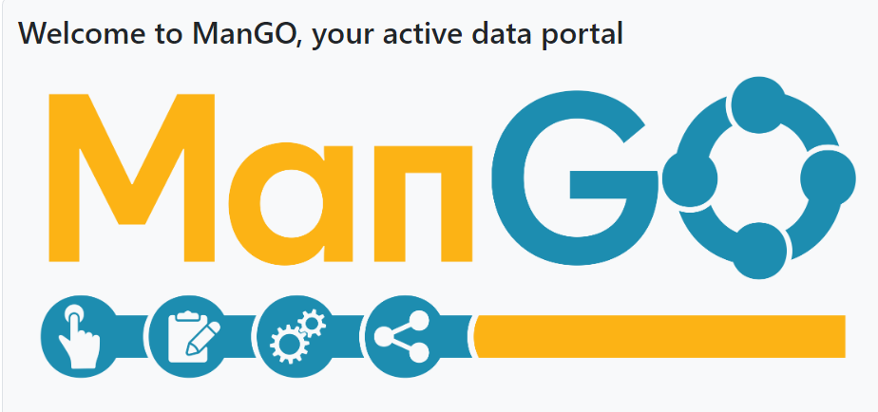



Collaboration with VSC
Globus file transfer
Data policy
Metadata collection
Notes:
Let Sebastian talk ☺

Slide 6
What do you know about HPC ?
What do you know about HPC ?

Slide 7
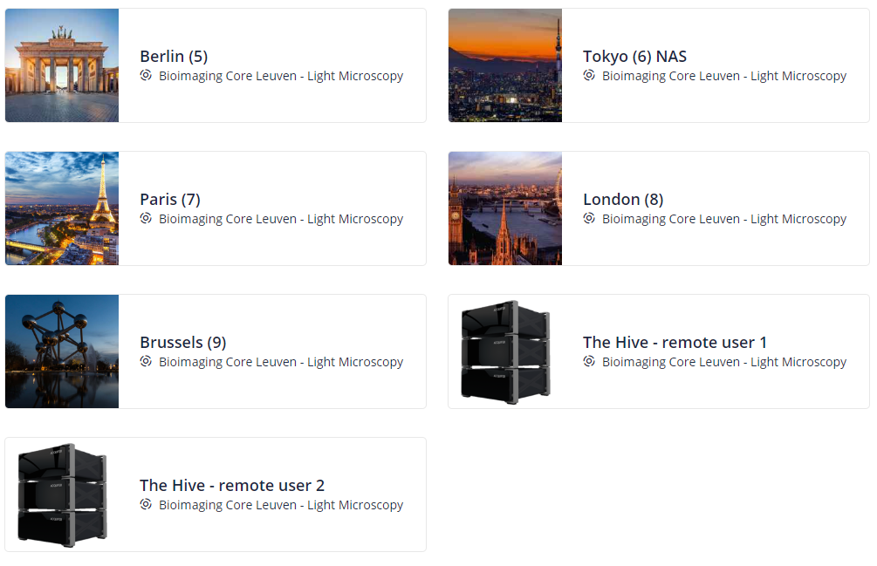
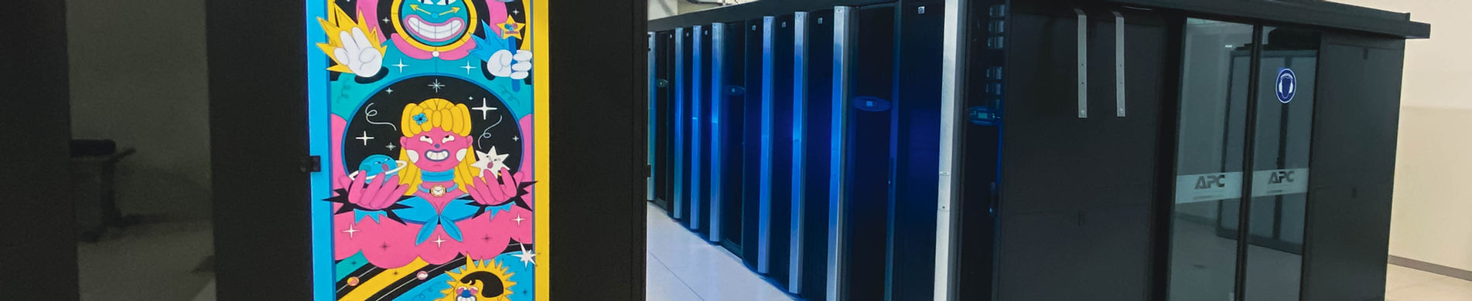
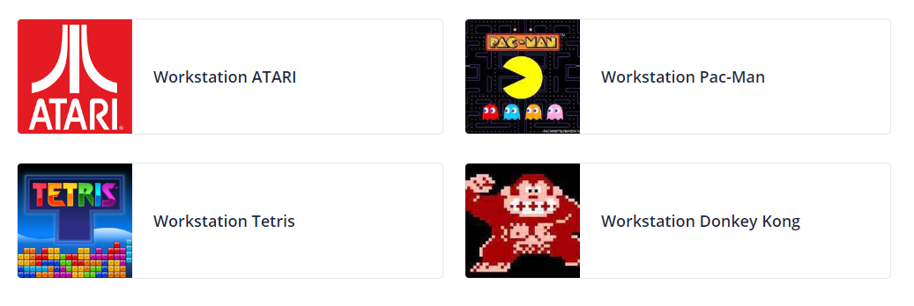
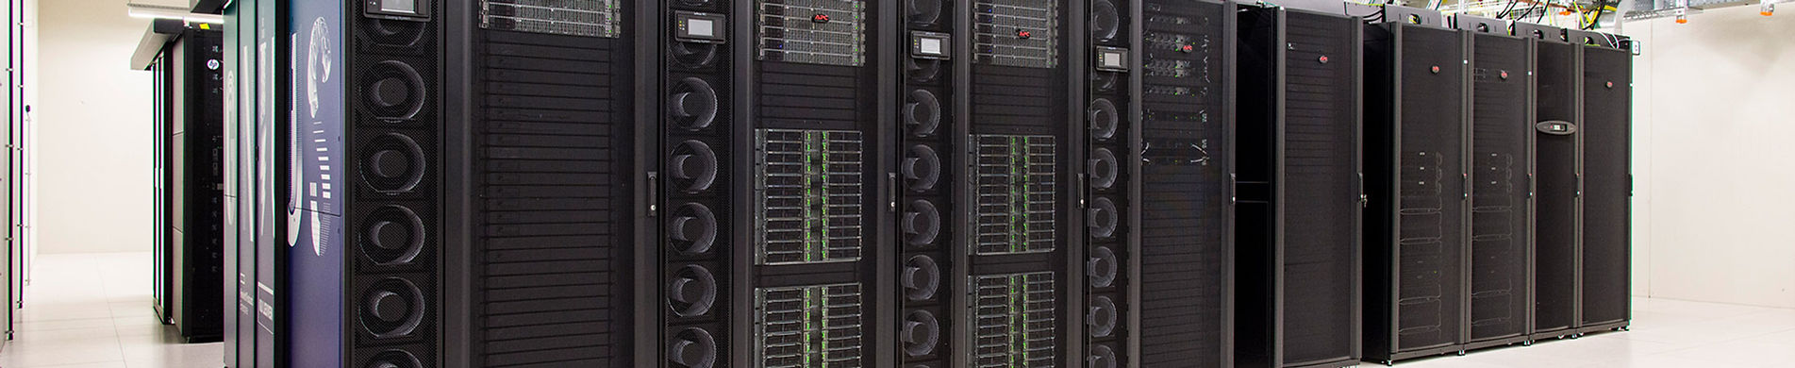
Now vs future
Remote access
Powerful desktop
High Performance Computing (HPC)
Notes:
Add Lumi picture

Slide 8
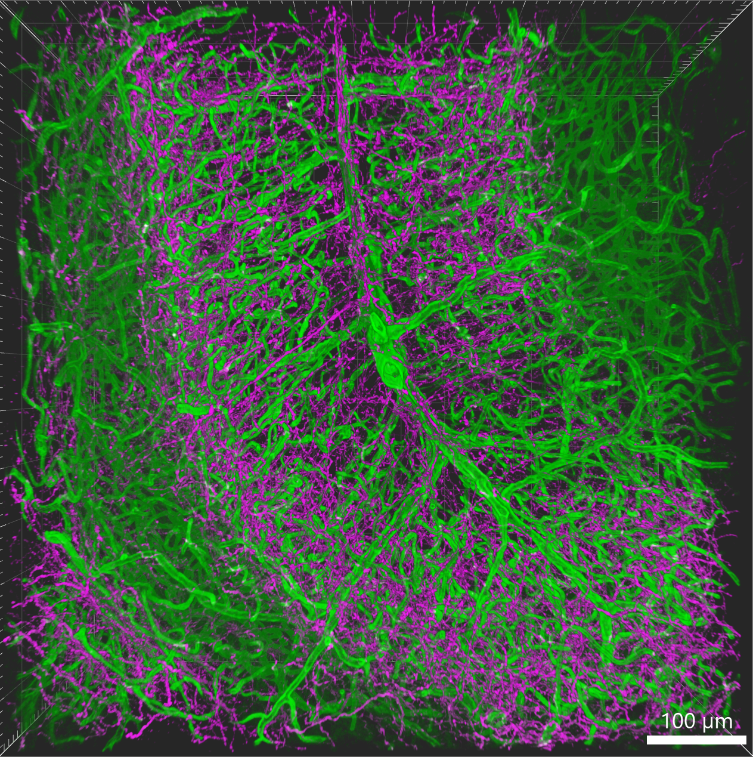
Use case for HPC
Visualization of large dataset
Analysis of a large dataset
File conversion
Reproducibility
With the courtesy of Nicolas Peredo (VIB, BIC Leuven)

Slide 9

Flemish supercomputer centre (VSC)
Partnership between 5 Flemish universities (https://www.vscentrum.be/)
Tier-2
accessible through university
Tier-1
Accessible through projects
Different services:
Consultancy
Research collaboration
Trainings
Notes:
Flemish supercomputer : 5 Flemish university=> Tier 2 (provincial level) and Tier1 (regional level + mention projects), service

Slide 10



High performance computing
Tier-0
European
Tier-1
Regional/national
Tier-2
University
Tier-3
Desktop
Notes:
Explain the different level, start from the bottom, hive = Tier 2.5, Tier2, from Tier1: access through projects (mention academic don’t pay, industry do)

Slide 11
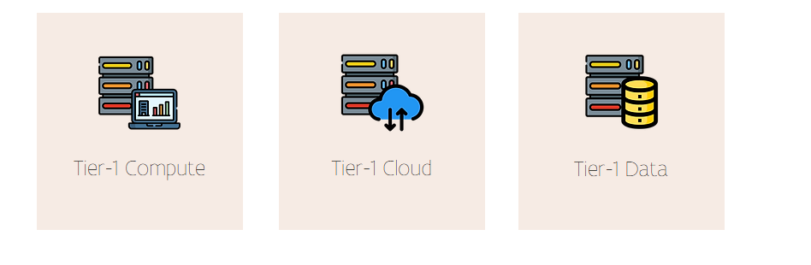
VSC components
Notes:
Today, we use 2 components: - analysis and data for storing, mention we will investigate tier-1 cloud future project

Slide 12

Questions
Where do you save the data?
Where do you the analysis ?
Where do you start when you log in?
Where to create the environment?
$VSC_HOME​ (low storage) $VSC_DATA​ (middle storage) $VSC_SCRATCH​ (large storage) $VSC_SCRATCH_PROJECTS_BASE​
(large storage)
Notes:
Activity: vsc home: logging, analysis: scratch_projects_base, vsc_data: code , data: backup if not to big in data

Slide 13
Structure cluster VSC
 | Tier-2 UGent | Tier-2 KULeuven | Tier-2 UA | Tier-1
$VSC_HOME | 3GB | 3 GB | 3GB (20000)
$VSC_DATA | 25GB | 75 GB | 25GB (100 000) | = Tier-2 from institute
$VSC_SCRATCH | 25 GB | 500 GB | 50GB | 3 GB (files 1048576)
$VSC_SCRATCH_PROJECTS_BASE |  |  |  | 10 TB (files 1048576) **
Check quota | quota | myquota | quota | my_dodrio_quota
Backed-up
Not
backed up
** With a good justification more can be requested
Notes:
Adapt color code, add backup and what it should contain

Slide 14


Creating a job: what you need
Queue for different types of jobs:
Memory
Presence | type of GPUs (NVIDIA, AMD)
Test queue (i.e. debug_queue)
Reservation:
To fast queueing
Used in projects
Used in training
Our flag for reservation
VIBtraining
Notes:
Queue systems : resources with different queue, depending on #people and resources asked more or less queue

Slide 15
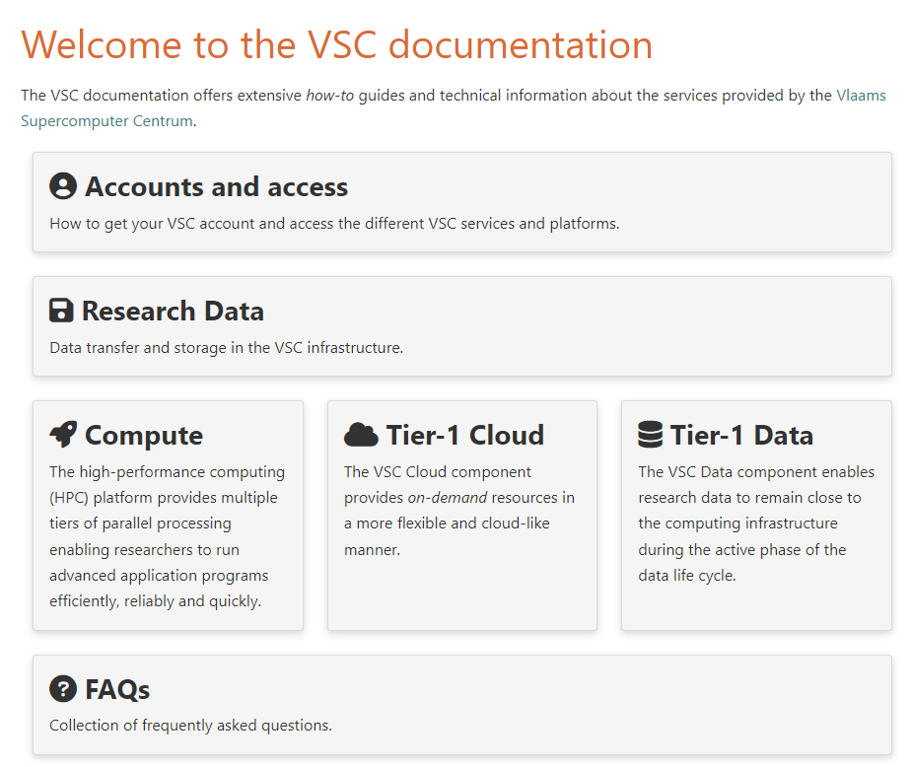
Documentation
Documentation VSC : link
What is the infrastucture
How to run jobs
Software info
How to request something
Activity:
Let’s navigate together!
Notes:
# navigate with them
Compute=> where to save data
Software
How to build software

Slide 16
Session 2: Infrastructure
29/05/2024, Leuven

Slide 17

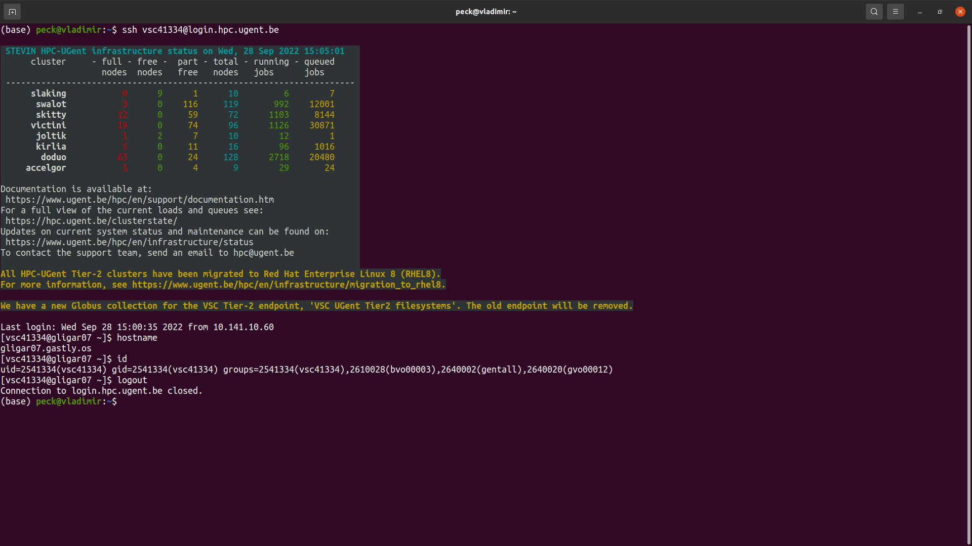
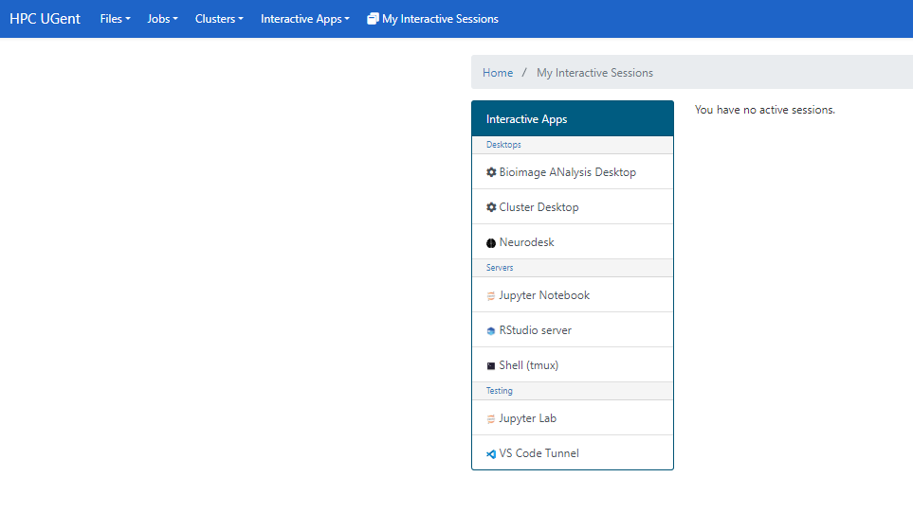
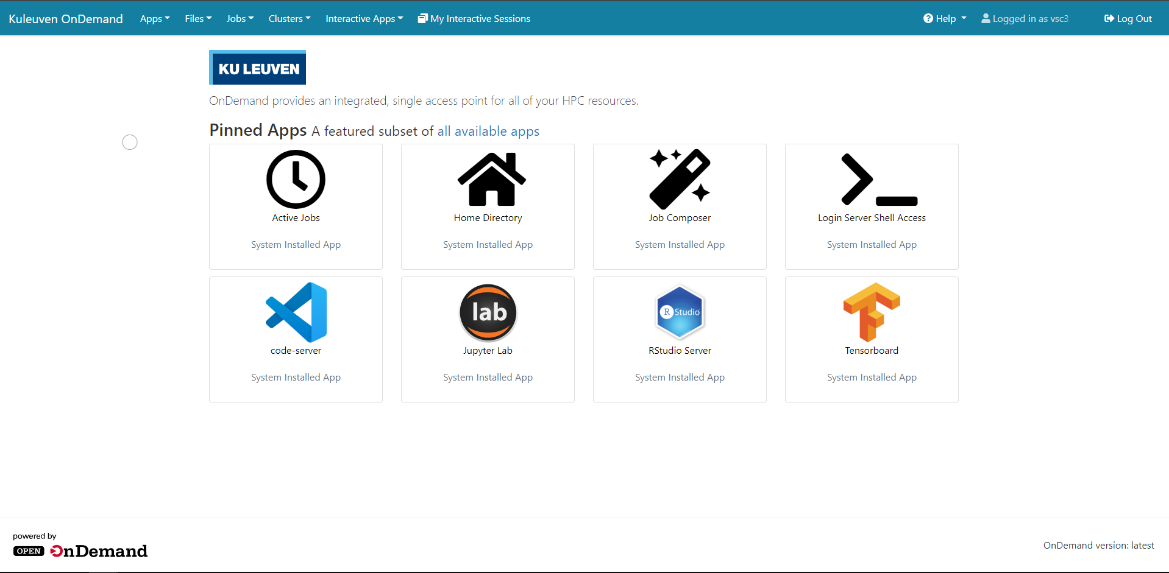
HPC before and now
Notes:
Slide after asking what do you know about HPC.
Question: when is the first HPC built?
Make the terminal bigger and put a picture of open on demand

Slide 18
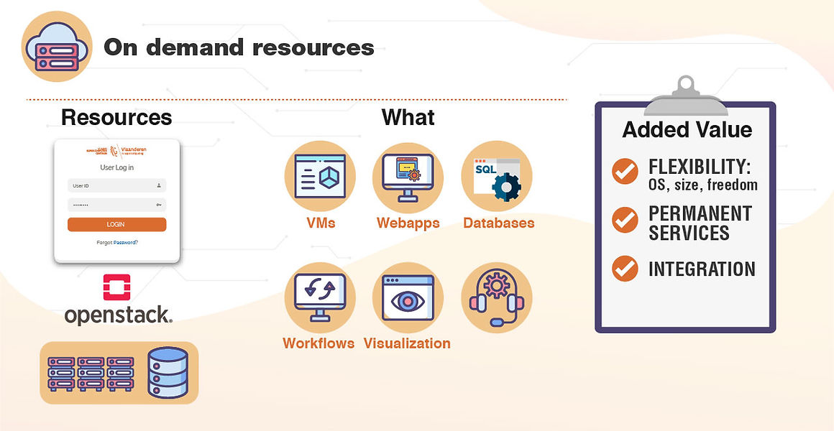
Open OnDemand framework
https://tier1.hpc.ugent.be/

Slide 19
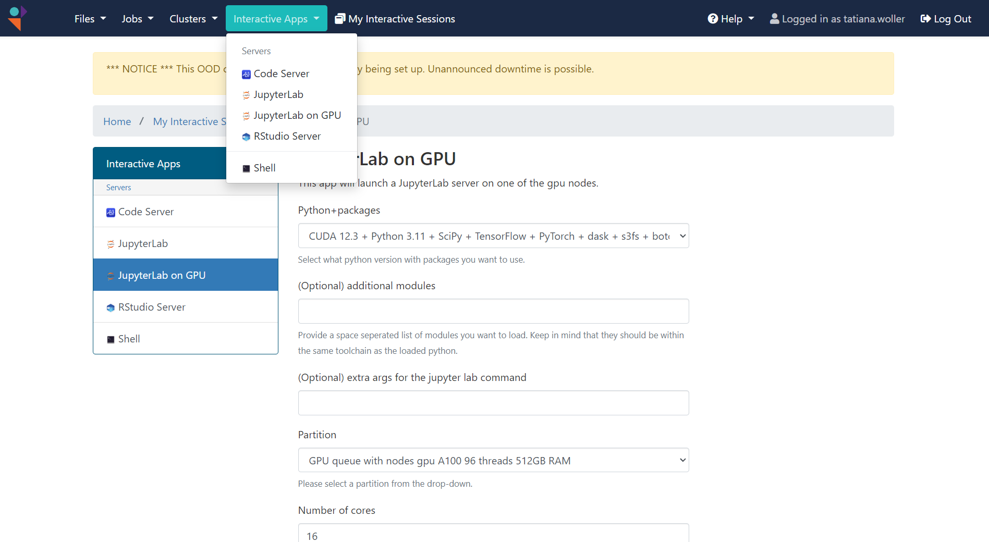
VIB compute
https://connect.vib.be/facilities/data-core

Slide 20














Different HPC flavours
Tier-2 UGent Tier-2 KUL
VIB compute Tier-1

Slide 21

Open OnDemand framework what to use
Image analysis on a remote desktop
Run a jupyter notebook with 2D visualization
Run automatic processes on a lot of files without visualization

Slide 22
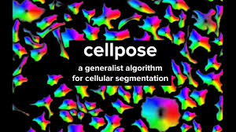



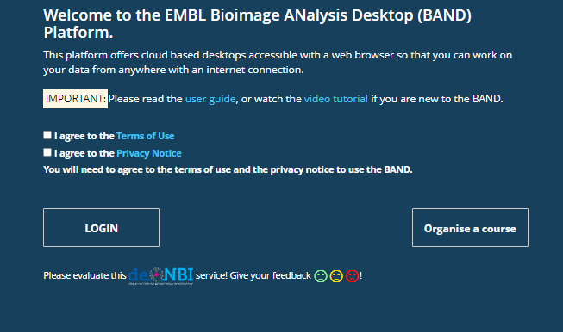




BAND: Bioimage Analysis Desktop

Slide 23
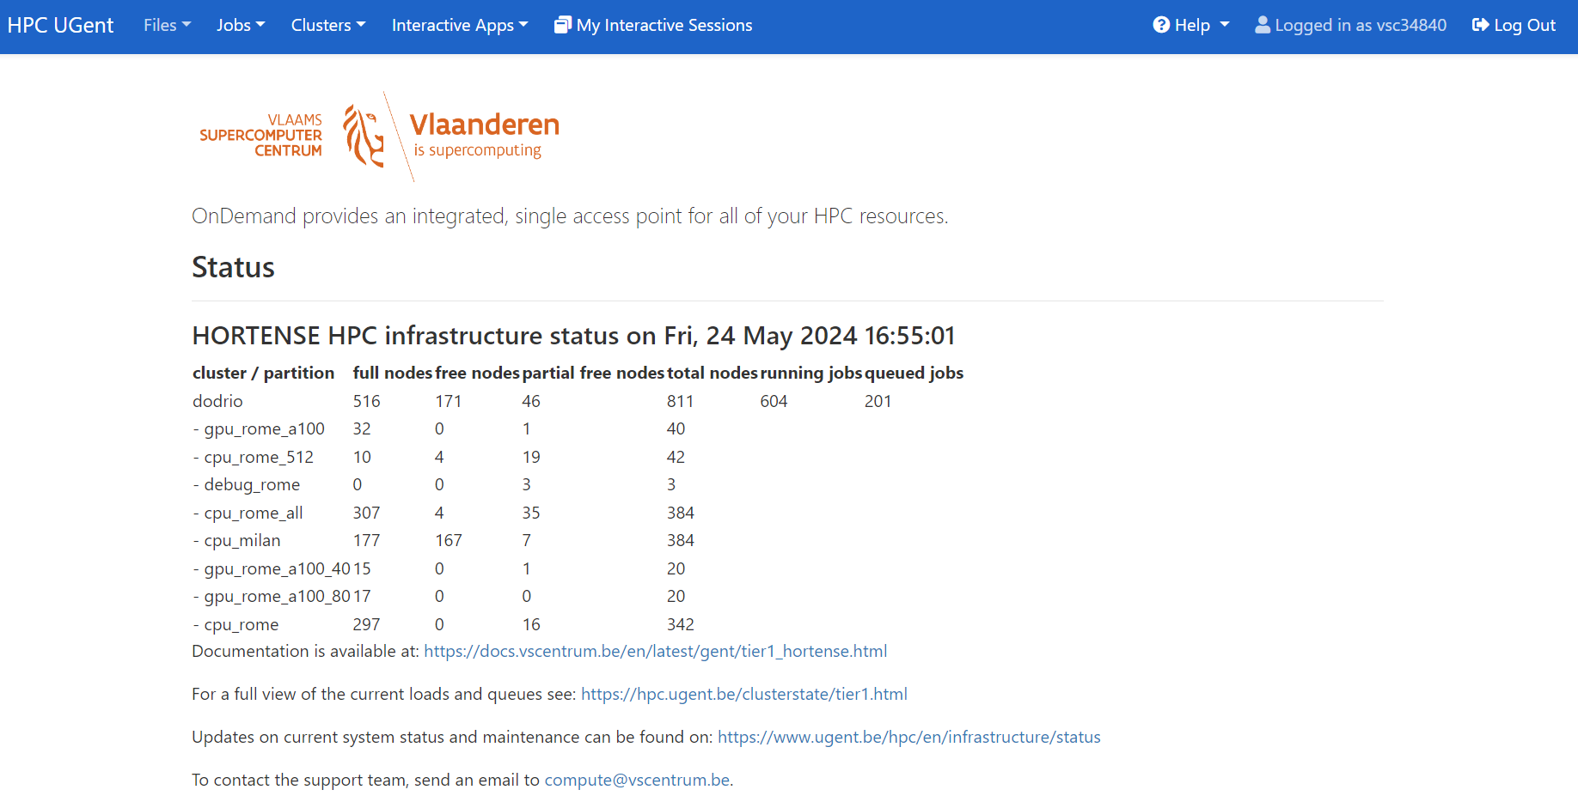
How to log in to Open On Demand
https://tier1.hpc.ugent.be/
Authentication through application (KUL, Microsoft)
Notes:
Go to url and do the authentification

Slide 24
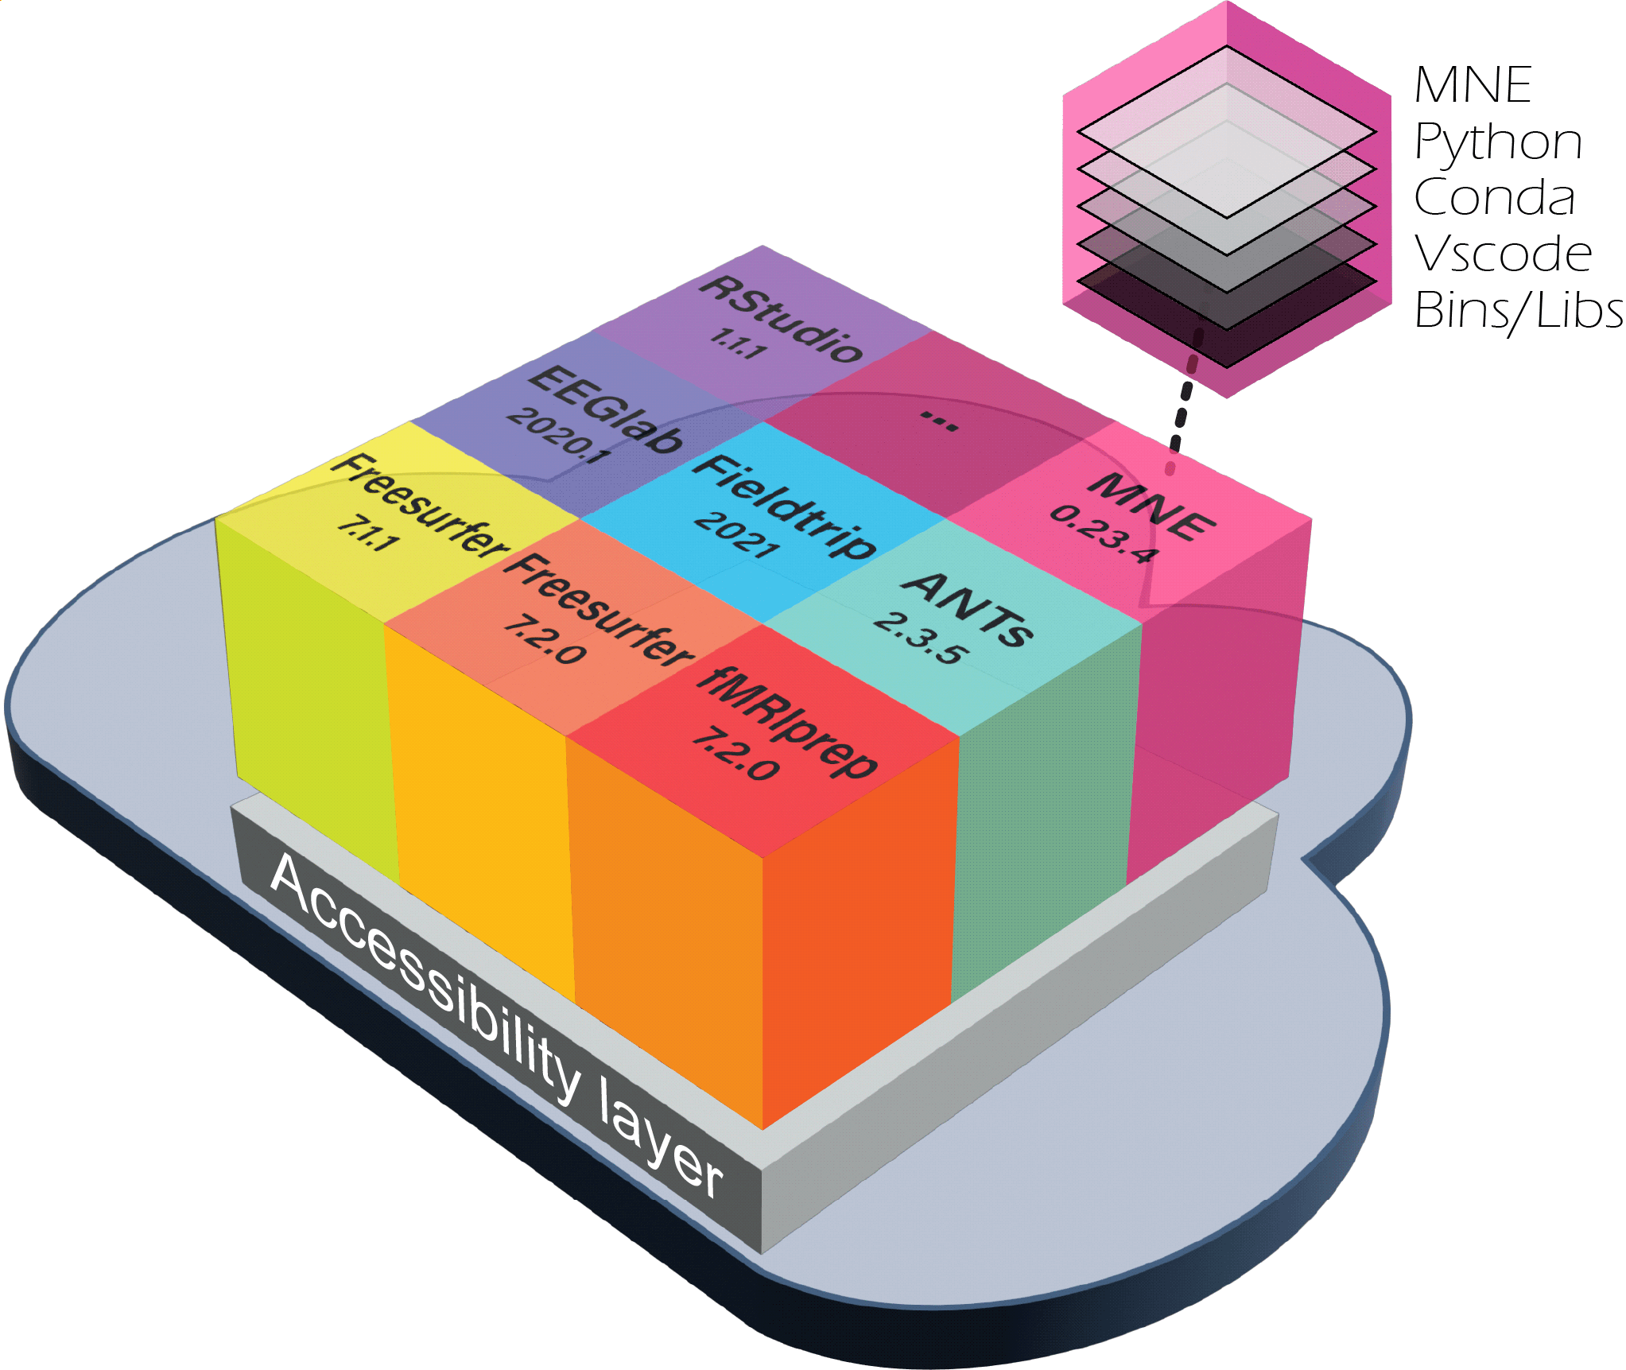
Neurodesk: for data analysis in neuroimaging
Resources
GitHub - NeuroDesk/example-notebooks: examples for using Neurodesk within Notebooks
Tutorials
Publication (doi:10.21203/rs.3.rs-2649734/v1)
Neurodesk: An accessible, flexible, and portable data analysis environment for reproducible neuroimaging
Desktop application
Slicer
Vesselvio
Ilastik

Slide 25
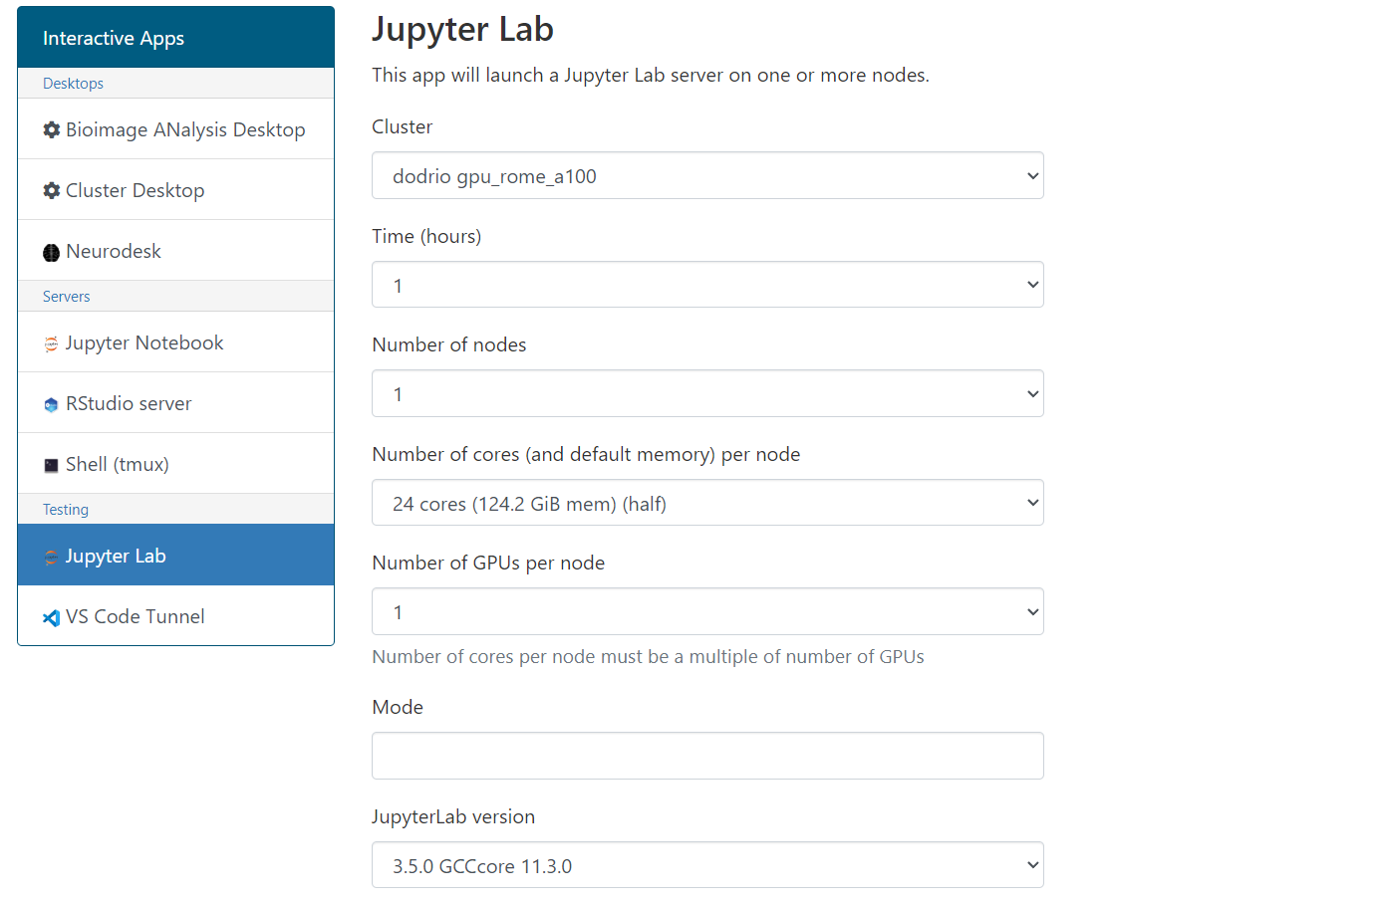
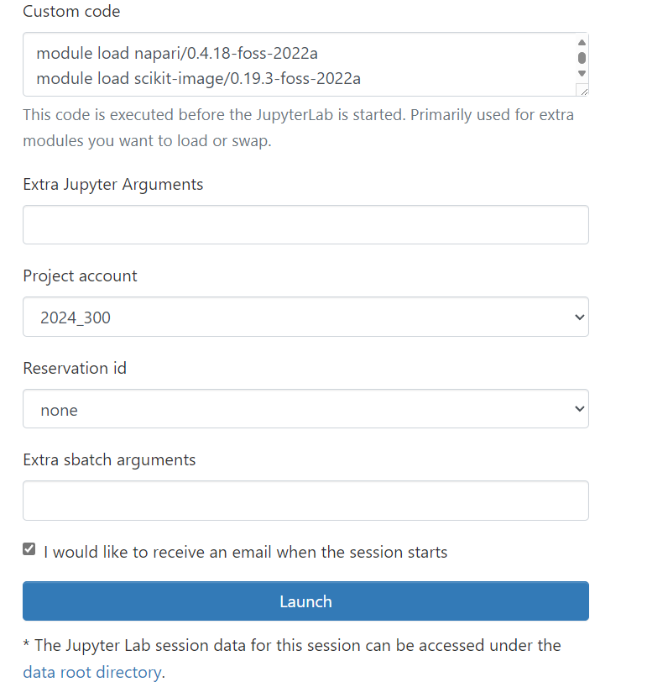
Jupyterlab
VIBtraining

Slide 26
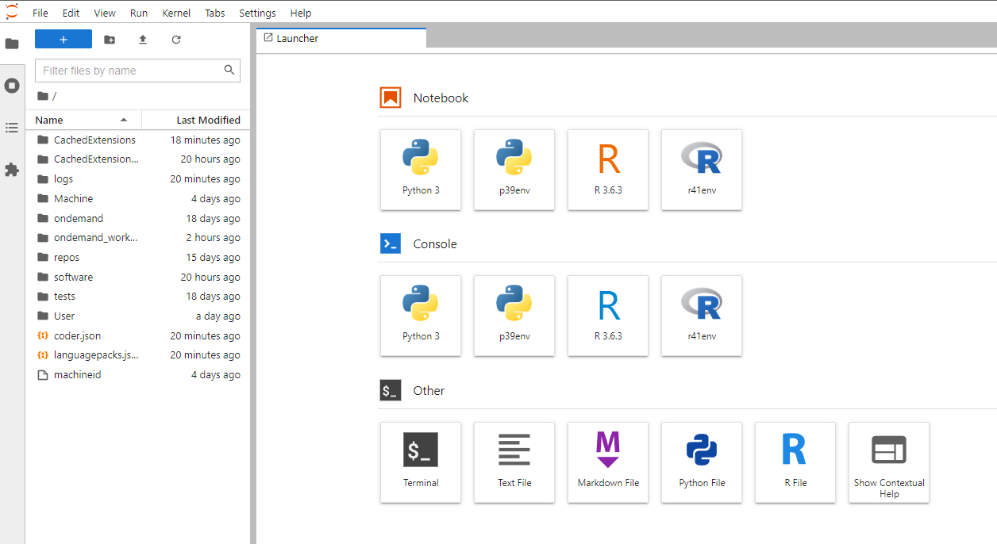
Jupyterlab

Slide 27
Which part of the VSC should I use for the following processes ?
A file conversion of a large lightsheet (100 GB) dataset to a standard format (OME-TIFFs)?
Fiji script to do the skeletonization of a brain sample ?
Denoising of an EM dataset using a notebook ?

Slide 28
Session 3: Data transfer
29/05/2024, Leuven

Slide 29
How to log in to Open On Demand
https://tier1.hpc.ugent.be/
Authentication through application (KUL, Microsoft)
https://tier1.hpc.ugent.be/
Notes:
Go to url and do the authentification

Slide 30
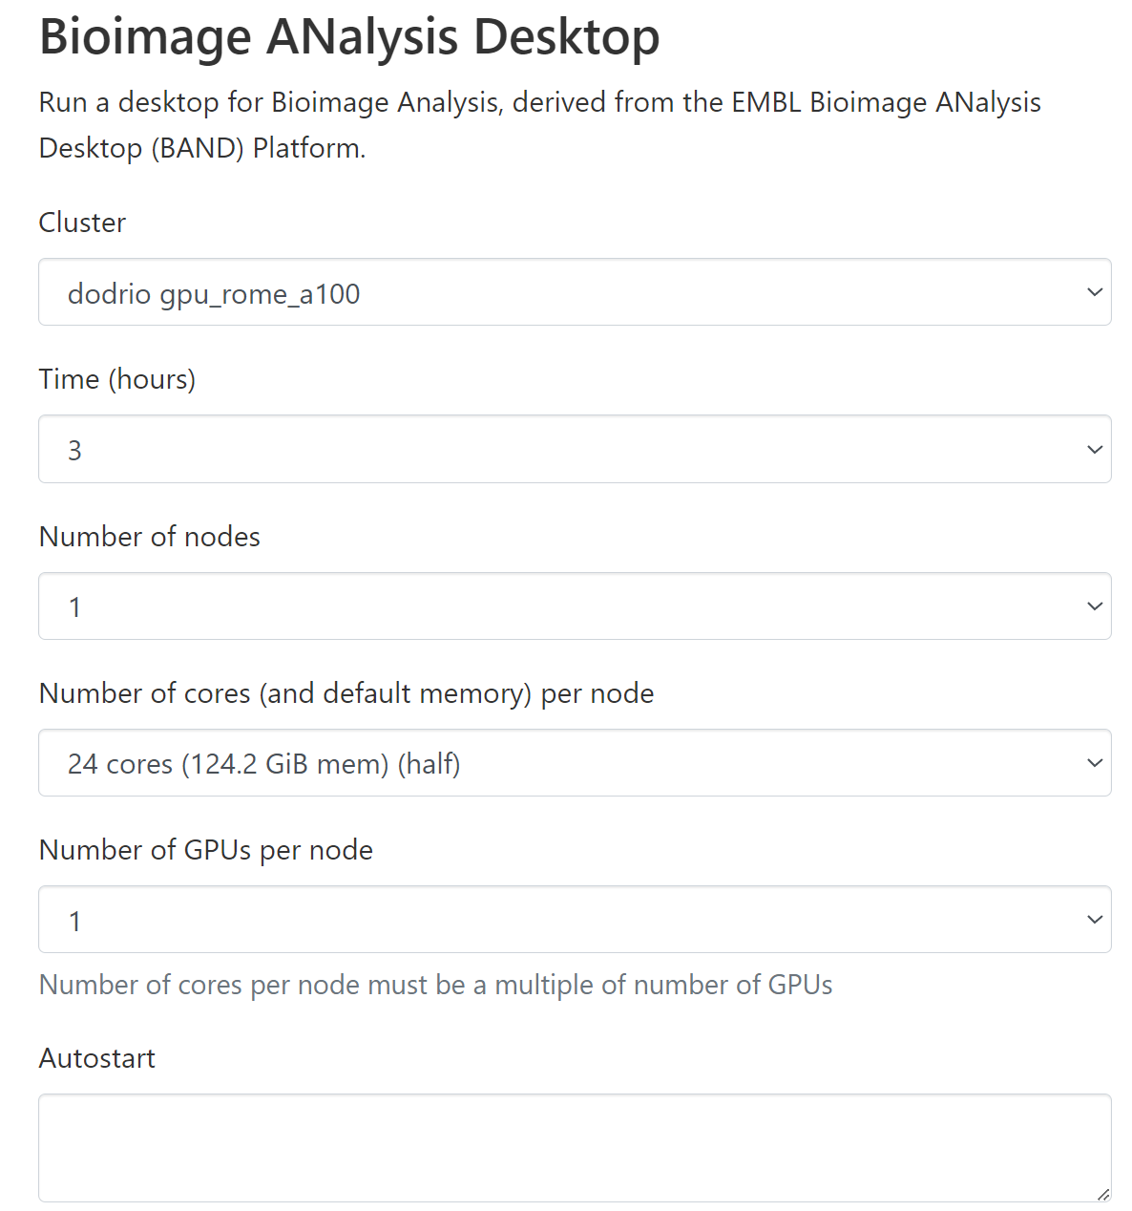
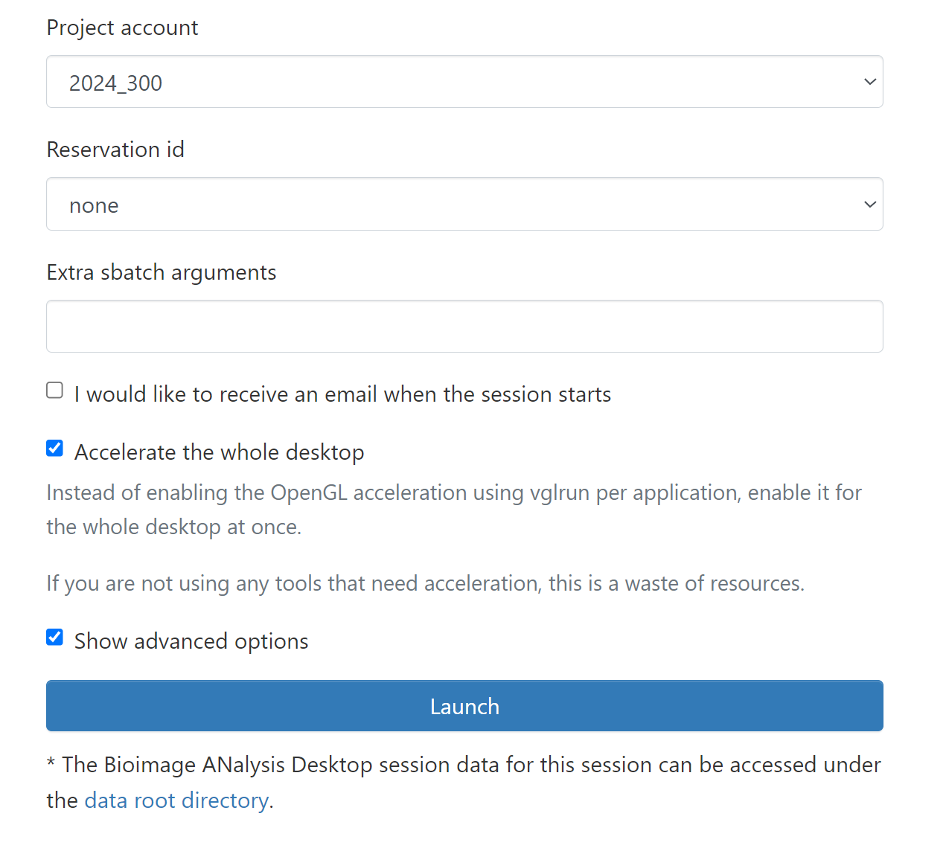
How to start BAND on the VSC
VIBtraining

Slide 31




A lot of software is installed on VSC
How to find software:
$ module av
$ module spider <software_name>
How to (un)load a software:
$ module load <software_name>
$ module unload <software_name>
$ module purge
Check which module is loaded:
$ module list
How to swap a module:
$ module swap …

Slide 32
Some useful command
Where are you: $pwd
To go to a map: $cd
To list the content of a map: $ls
To make/remove a map: $mkdir / rmdir
Check memory quota: my_dodrio_quota

Slide 33

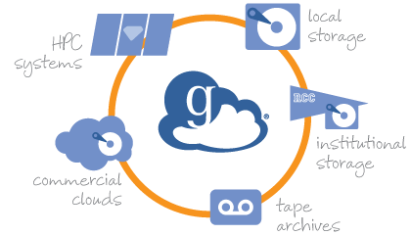




Globus enables a unified Access across disparate systems
Regional resources
Globus
HPC environment
Personal systems
Public cloud storage
Archive,
Repository
Microsoft Azure
Instrument
Notes:
To do add: globus explanation, mention bioimage archive and empiar

Slide 34

Data transfer
Possibilities
PC to Scratch
Scratch to Data
Automatic backup
To Data
Overnight
Computer can be off

Slide 35
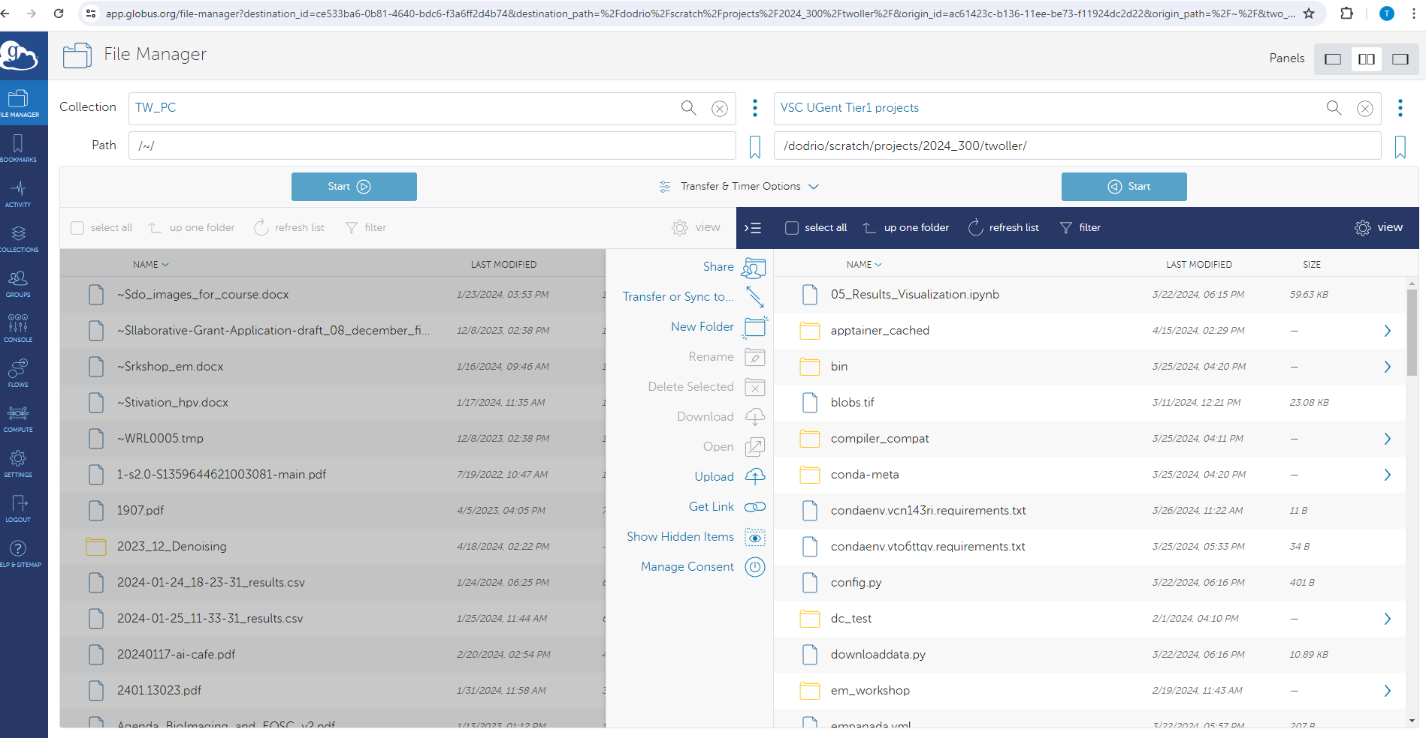
From your PC to $VSC_SCRATCH_PROJECT_BASE
Your_PC_name
name
https://www.globus.org/globus-connect-personal

Slide 36
Exercise: how to use Globus
Installation: Globus personal: https://docs.globus.org/globus-connect-personal/install/windows/
Go to HPC_training_Bioimaging and transfer the 3d.tif from your pc or L-drive to $VSC_SCRATCH_PROJECTS/2024_300/username

Slide 37
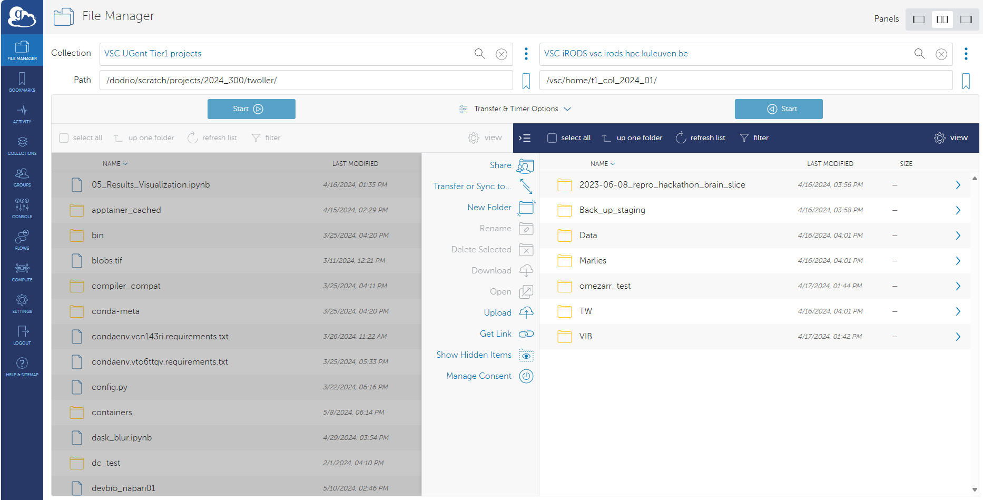

From $VSC_SCRATCH_PROJECT_BASE to backed-up data
Your_PC_name
name
https://www.globus.org/globus-connect-personal
Notes:
If time: do an exercise (add people to the collection)
Otherwise demo

Slide 38
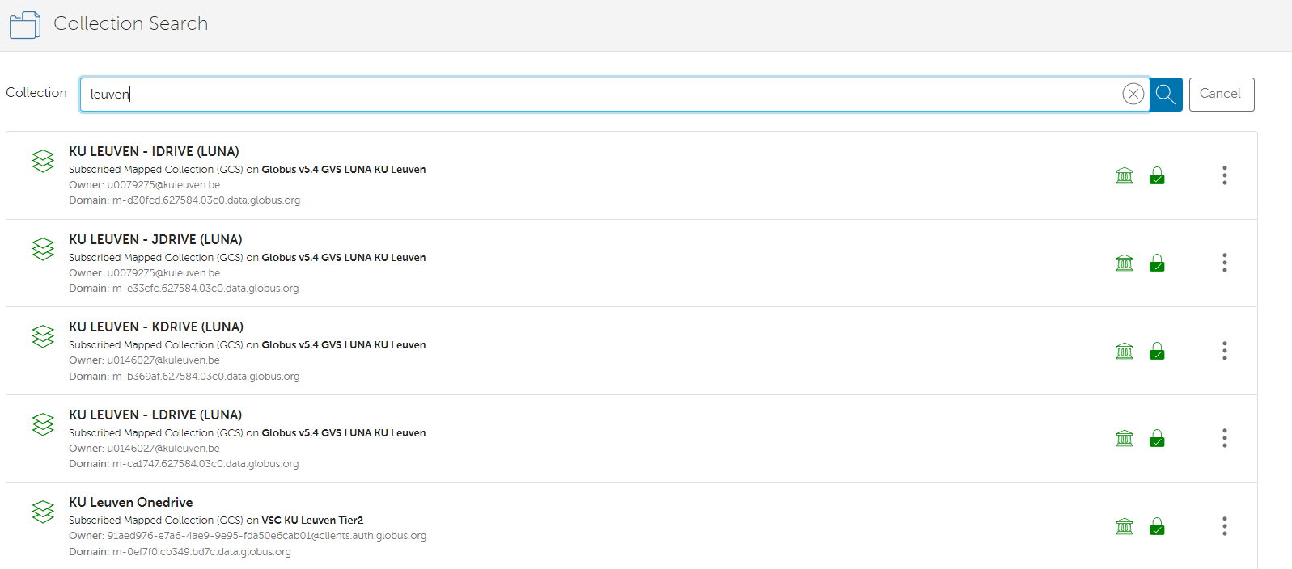
For Leuven: copy back to external drive
Notes:
Mention VIB share data ?

Slide 39
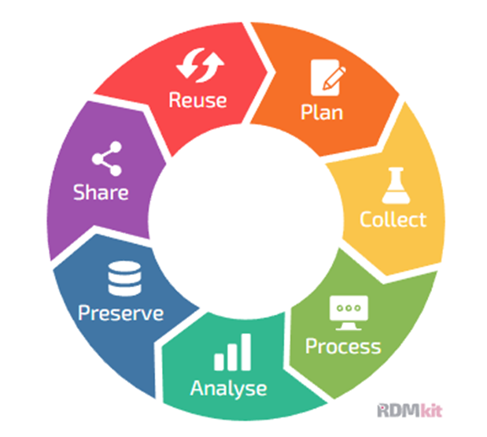

Why do we care about data management?

Slide 40
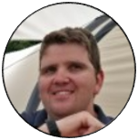
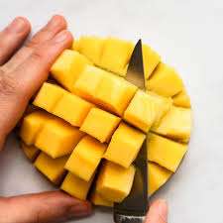

What to do with your data
Data
common folder with globus
Tier-1 data
Raf De Coster
Good practices and RDM
Test project
automatic transfer
metadata extraction
FOR THE FUTURE !!!

Slide 41
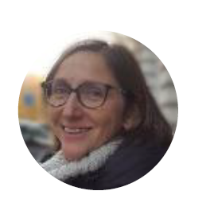

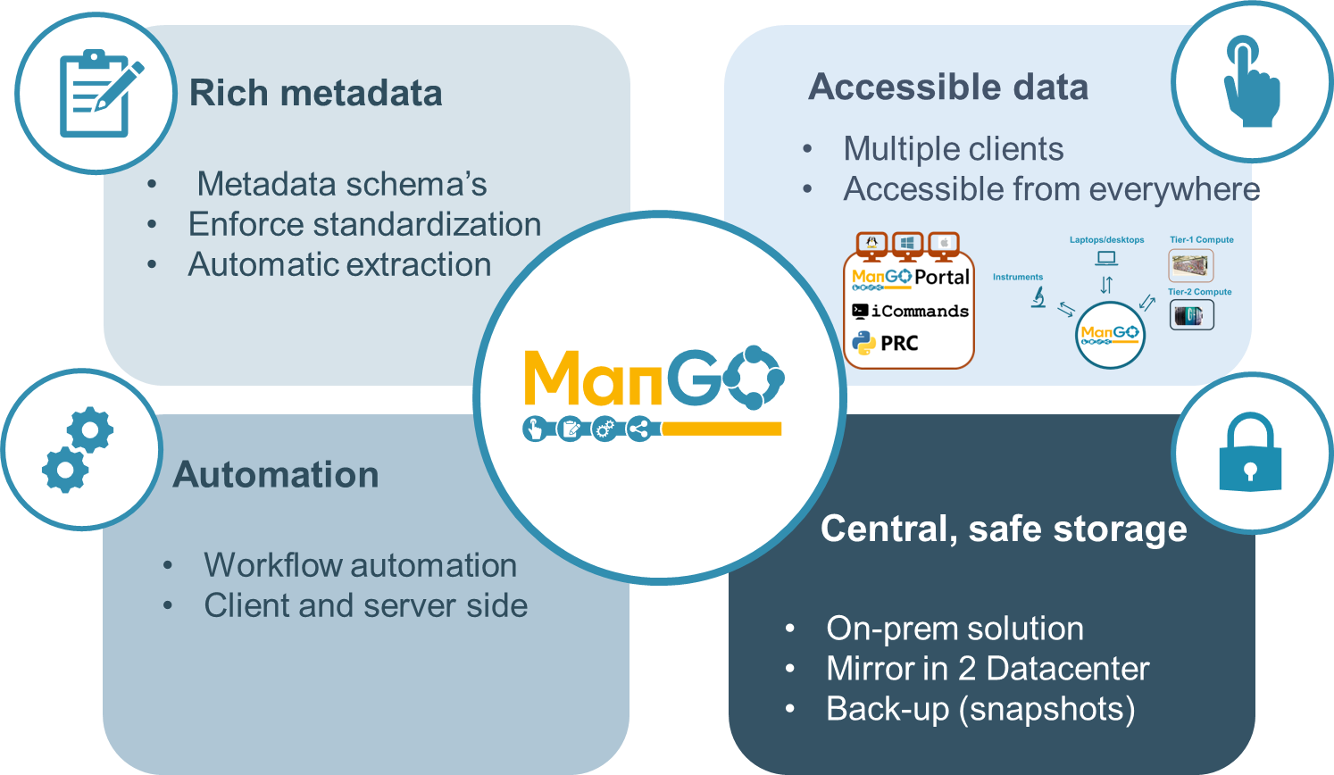
What is ManGO ?
Ingrid Barcena Roig
Integrated Rule-Oriented Data System (iRODS)
open source data management software
used by worldwide.
Research
Commercial
Governmental organizations

Slide 42


Where to save data
Other option:
A Metadata Platform for the Modern Data Stack

Slide 43

RDM: where to save your code
For your code :
BIC GitHub repository: vib-bic-code
BIC GitHub training: HPC_training_Bioimaging
VIB course
next GitHub session in September
RDM session after summer
Notes:
Show Benjamin repository

